Slide 1
Other Machine Learning Models
Lei Qian, Ph.D.

Slide 2
Decision Trees

Slide 3
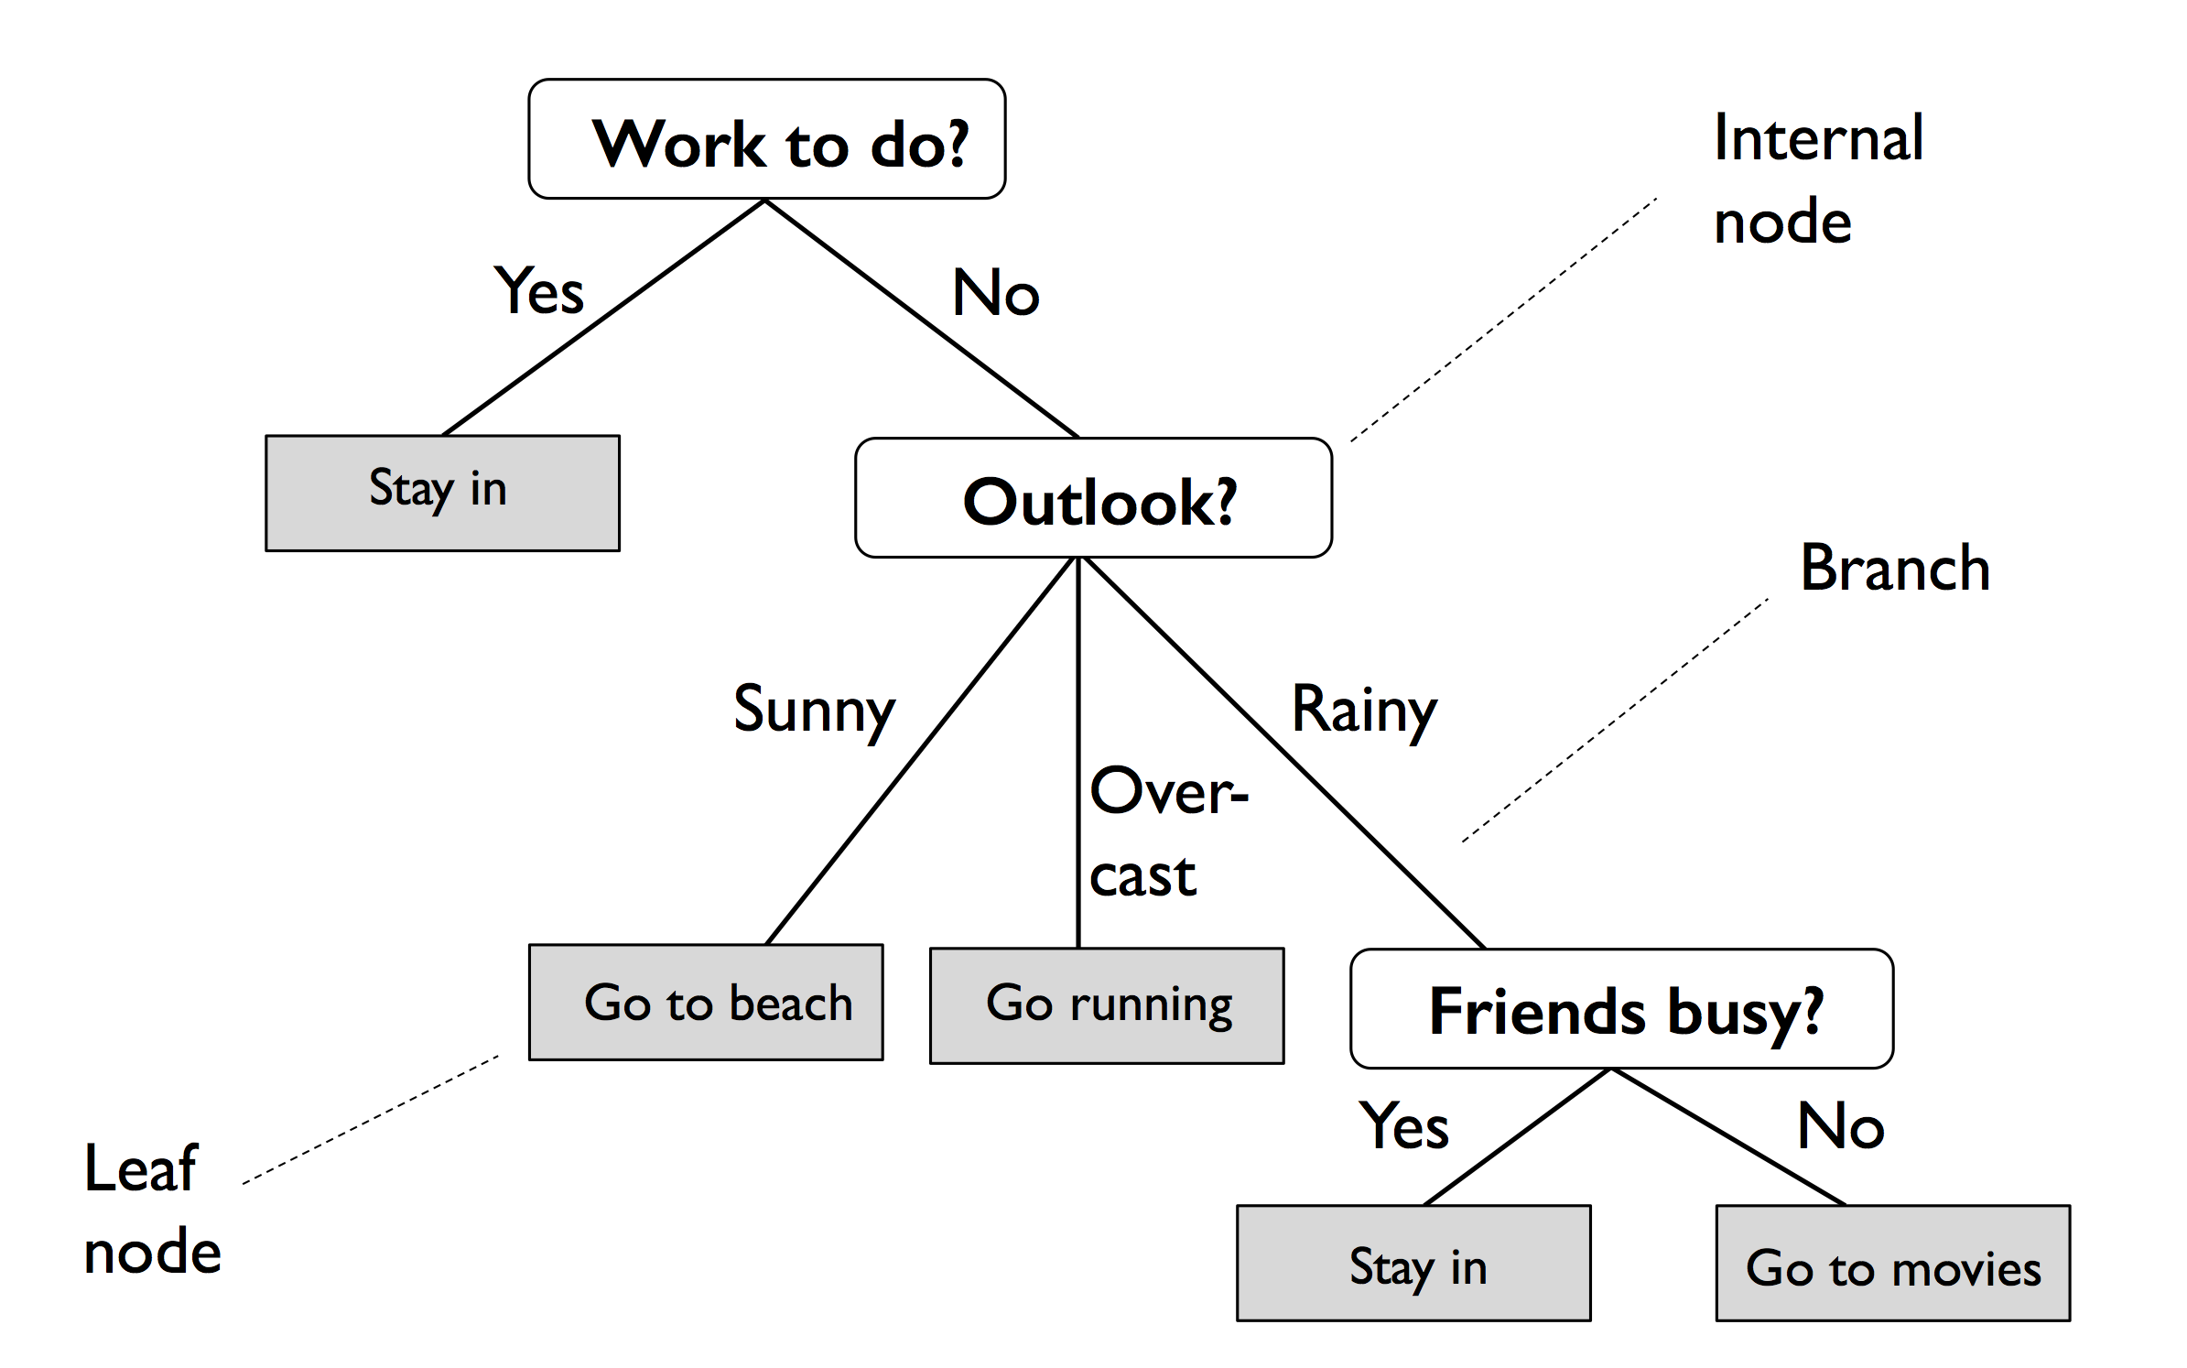
Decision Tree
Decision tree classifiers are classifiers that use tree like model to predict outcomes. Based on the features in a training set, the decision tree model learns a series of questions to infer the class labels of the samples

Slide 4
Decision Tree
A decision tree is a directed tree consists of nodes, edges (branches) and leaves.
Each node specifies a test on an attribute
Each branch corresponds to an attribute value or condition
Leaves represent a class or decision.

Slide 5
Decision Tree
Advantages of decision trees:
Simple to understand and to interpret. Trees can be visualized.
Requires little data preparation. Other techniques often require data normalization, dummy variables need to be created and blank values to be removed.
The cost of using the tree (i.e., predicting data) is logarithmic in the number of data points used to train the tree.
Able to handle both numerical and categorical data. Other techniques are usually specialized in analyzing datasets that have only one type of variable.
Able to handle multi-output problems.
Uses a white box model. If a given situation is observable in a model, the explanation for the condition is easily explained by Boolean logic. By contrast, in a black box model (e.g., in an artificial neural network), results may be more difficult to interpret.
Possible to validate a model using statistical tests. That makes it possible to account for the reliability of the model.

Slide 6
Decision Tree
The disadvantages of decision trees include:
Decision-tree learners can create over-complex trees that do not generalize the data well (overfitting). Mechanisms such as pruning, setting the minimum number of samples required at a leaf node or setting the maximum depth of the tree are necessary to avoid this problem.
Decision trees can be unstable because small variations in the data might result in a completely different tree being generated. This problem is mitigated by using decision trees within an ensemble.
The problem of learning an optimal decision tree is known to be NP-complete under several aspects of optimality and even for simple concepts. Consequently, practical decision-tree learning algorithms are based on heuristic algorithms such as the greedy algorithm. Such algorithms cannot guarantee to return the globally optimal decision tree.
Decision tree learners create biased trees if some classes dominate. It is therefore recommended to balance the dataset prior to fitting with the decision tree.

Slide 7
Decision Tree Algorithm
A decision tree is built upon top-down, recursive, divide and conquer method.
Select best feature for root node. Construct a branch for every possible value of that feature.
Split data into mutually exclusive subsets for each branch.
Repeat this process recursively using only the portion of data arriving at each node.
Stop when training examples can be perfectly classified -> create a leaf node with the class decision
There are multiple algorithms for decision trees. Popular algorithms include ID3, C4.5 and CART.

Slide 8
Decision Tree in Scikit-Learn
from sklearn.tree import DecisionTreeClassifier
tree = DecisionTreeClassifier(criterion='gini', max_depth=4, random_state=1)
tree.fit(X_train, y_train)

Slide 9
Decision Tree in Scikit-Learn
A very nice property of decision trees is that we can visualize the tree comparing to many other machine learning algorithms that final estimators are mostly black boxes.
dot_data = export_graphviz(tree, filled=True, rounded=True,
class_names=['Setosa', 'Versicolor', 'Virginica'],
feature_names=['petal length', 'petal width'],
out_file=None)
graph = graphviz.Source(dot_data)
graph

Slide 10
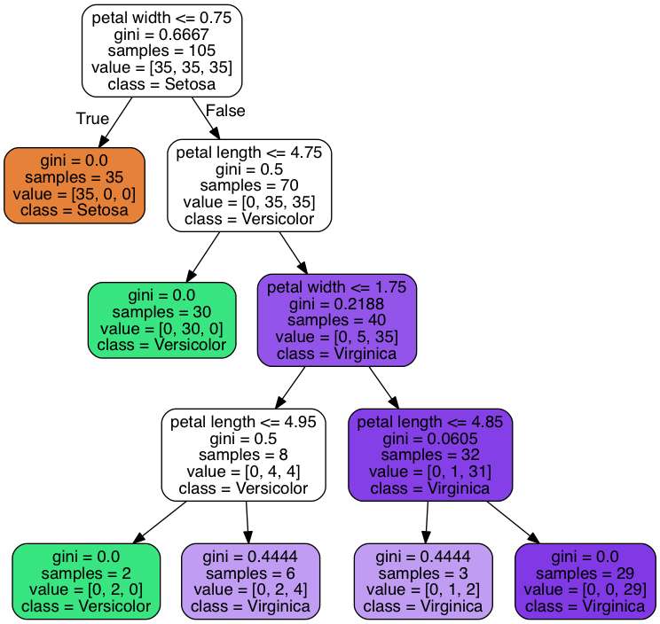
Example of a decision tree
The final decision tree:

Slide 11
Ensemble Learning

Slide 12
Ensemble Learning
Ensemble methods combine different classifiers into a meta-classifier that has better generalization performance than each individual classifier alone.
We will discuss the following methods:
Majority vote
Bagging
Adaptive boosting

Slide 13
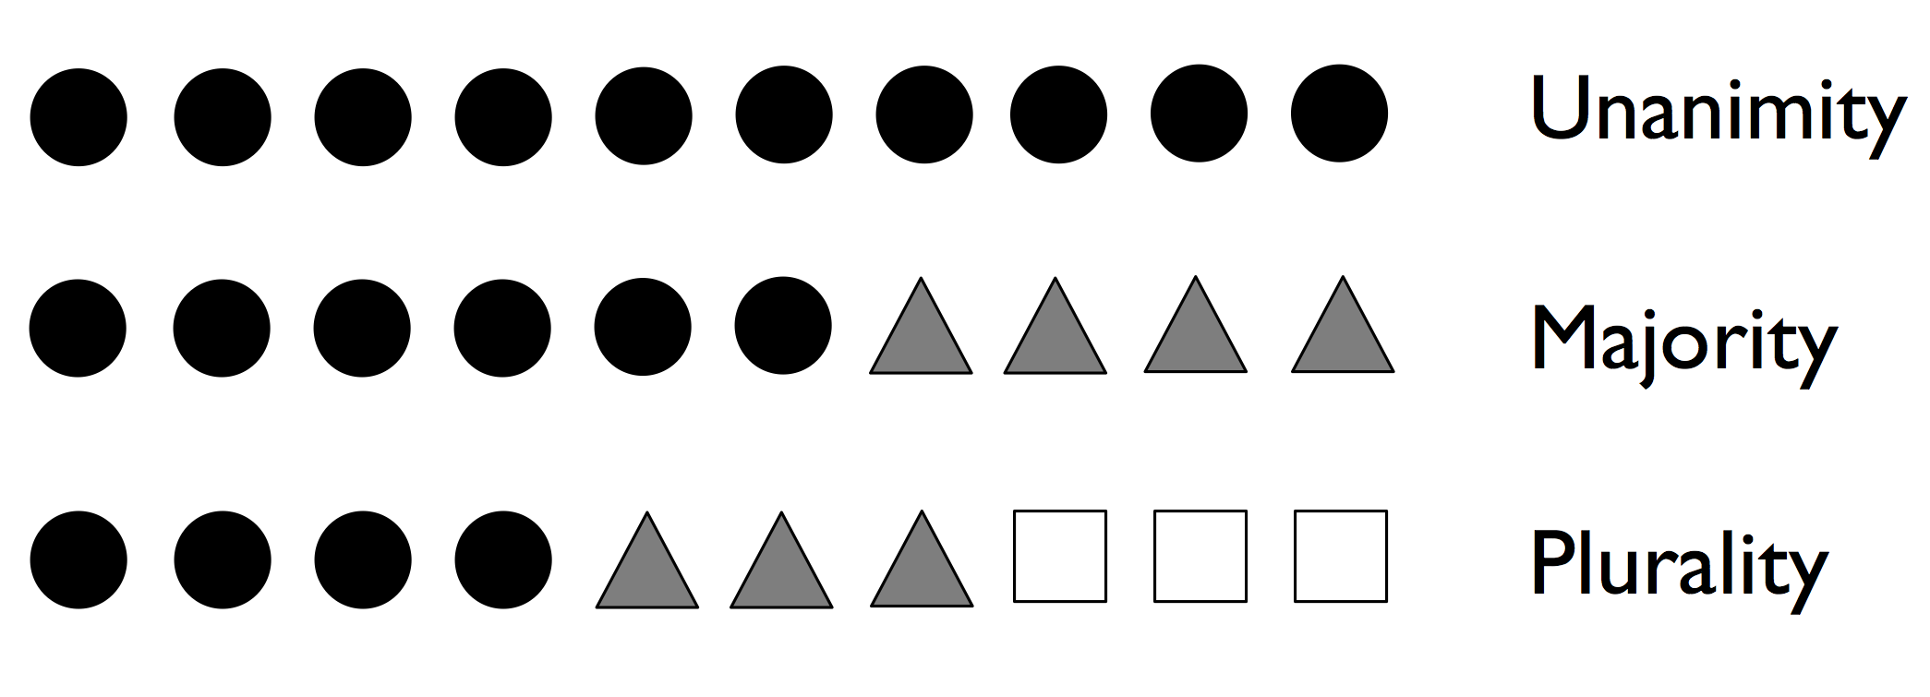
Majority Vote
Majority voting simply means that we select the class label that has been predicted by the majority of classifiers.
For binary classifications, it means the class received more than 50% votes is the prediction.
For multiple class classifications, it means the class received most votes is chosen. This is also called plurality voting.

Slide 14
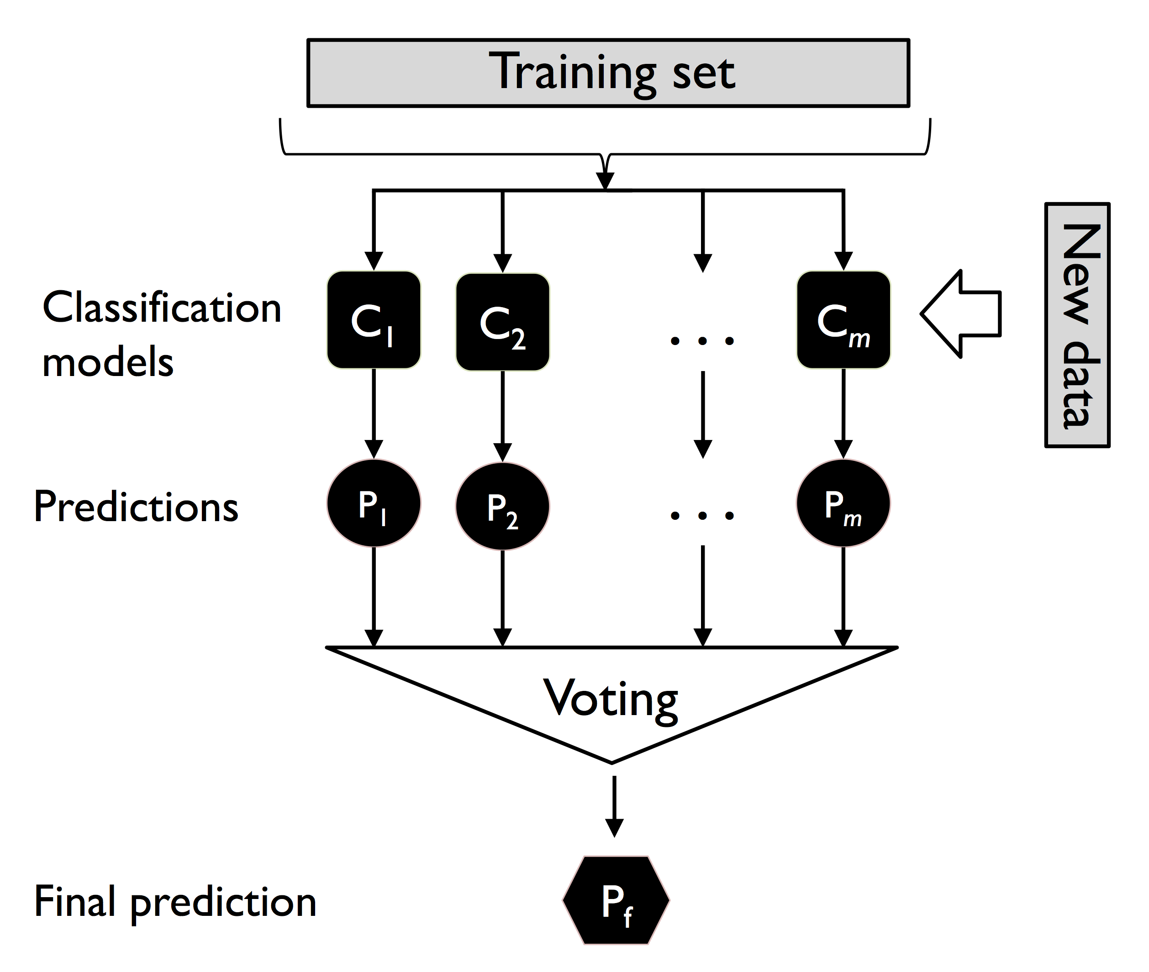
Majority Vote

Slide 15
Bagging
Bagging is an ensemble learning technique that is closely related to the MajorityVoteClassifier that we implemented in the previous section. However, instead of using the same training set to fit the individual classifiers in the ensemble, we draw bootstrap samples (random samples with replacement) from the initial training set, which is why bagging is also known as bootstrap aggregating.
Advantages of Bagging algorithm
Reduces Overfitting
Handles Noisy Data Well
Parallelizable
Random Forest is an example of bagging of decision trees.

Slide 16
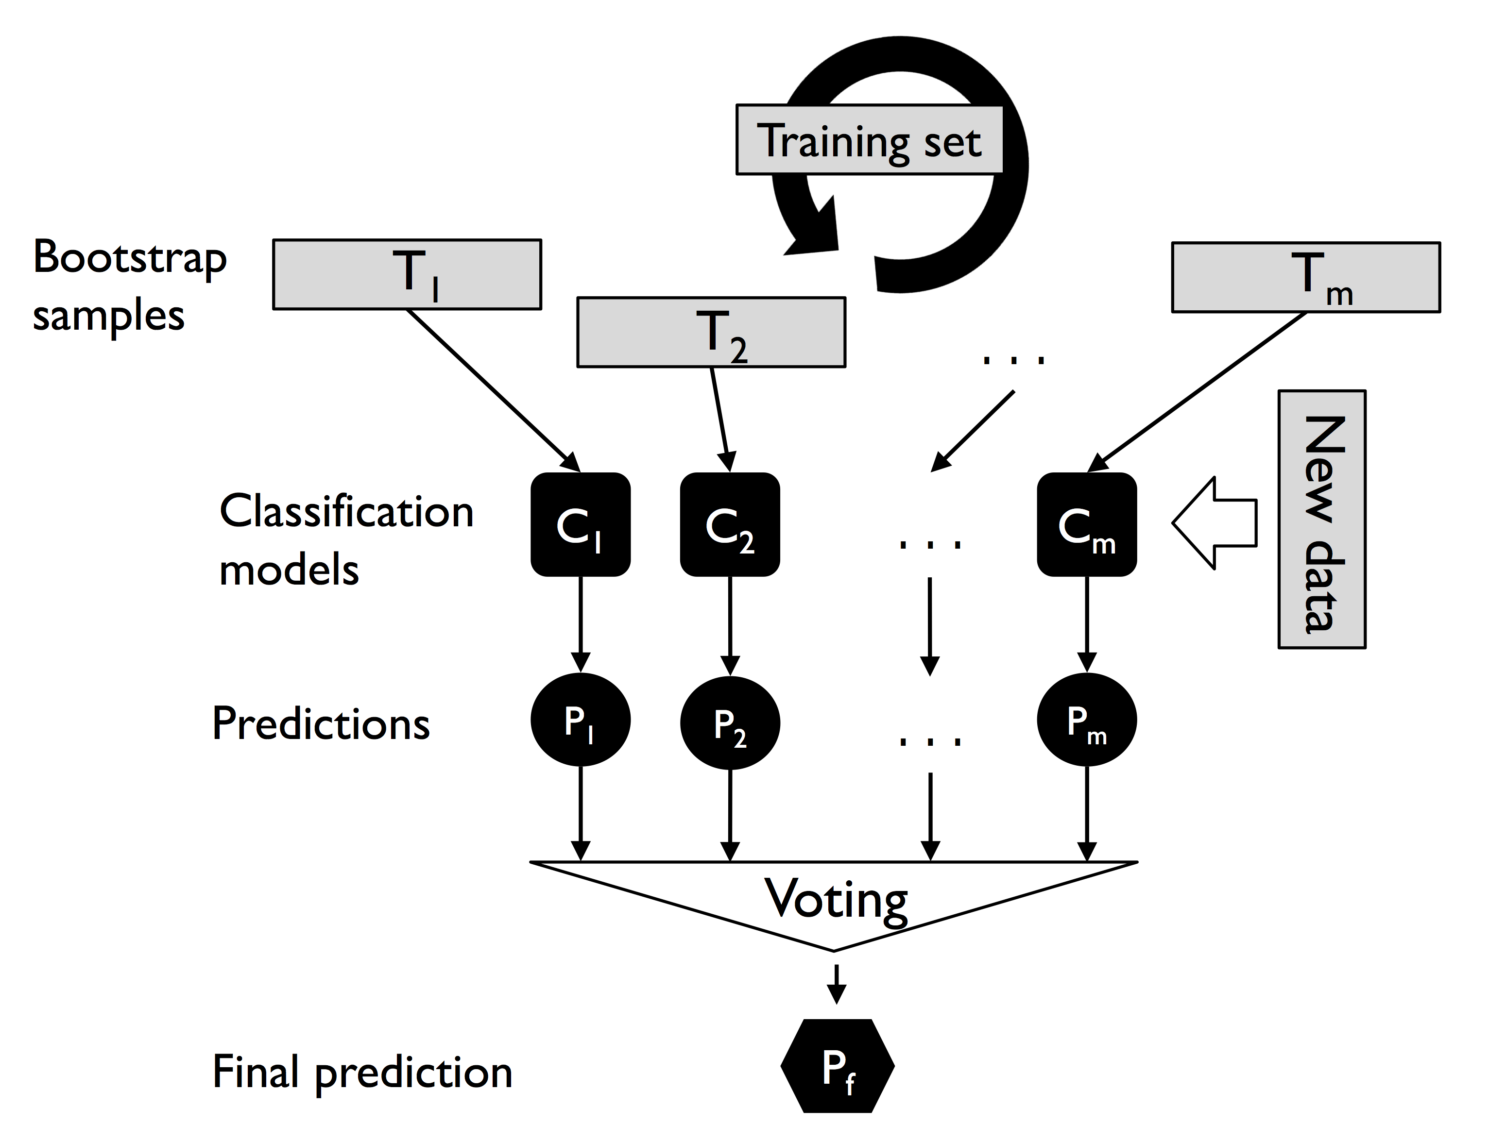
Bagging

Slide 17
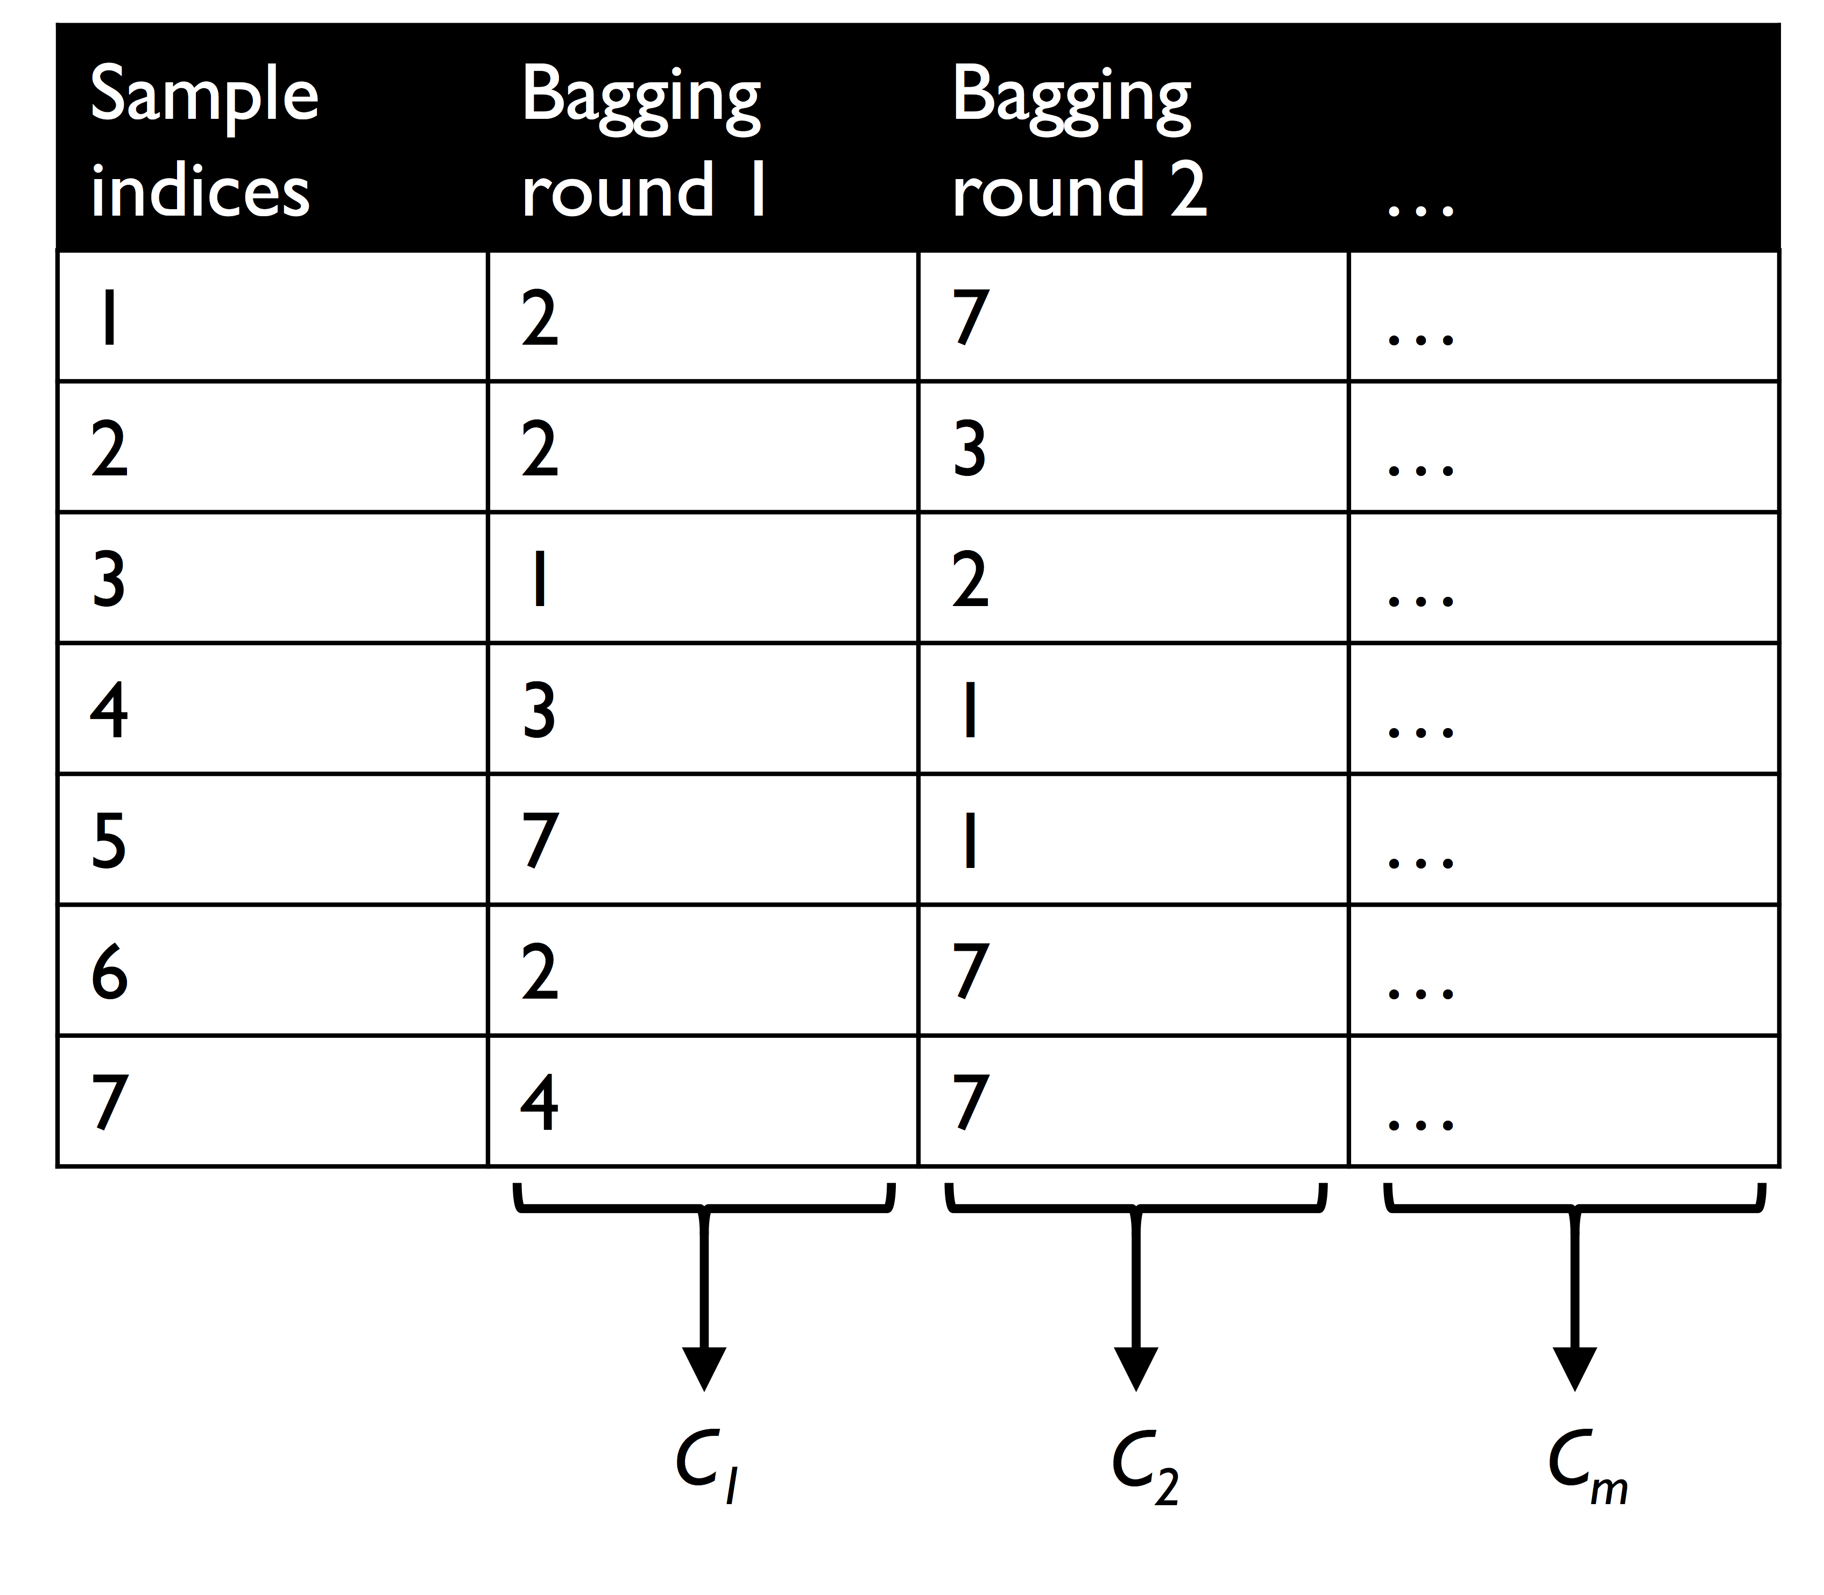

How bagging works
Let's consider the example shown in the following figure. Here, we have seven different training instances (denoted as indices 1-7) that are sampled randomly with replacement in each round of bagging. Each bootstrap sample is then used to fit a classifier $C_{j}$, which is most typically an unpruned decision tree:

Slide 18
Bagging in Scikit-Learn
tree = DecisionTreeClassifier(criterion='entropy',random_state=1)
bag = BaggingClassifier(base_estimator=tree, n_estimators=500,
max_samples=1.0, max_features=1.0, bootstrap=True,
bootstrap_features=False, random_state=1)
Now bag is an estimator. We can train it with the fit method:
bag.fit(X_train, y_train)
Predication can be made with predict method. Performance can be measured with score method.

Slide 19
Random Forest
Random forest is ensemble of decision trees. It works the following way:
1. Draw a random bootstrap sample of size n (randomly choose n samples from the training set with replacement).
2. Grow a decision tree from the bootstrap sample. At each node:
a. Randomly select d features without replacement.
b. Split the node using the feature that provides the best split according to the objective function, for instance, maximizing the information gain.
3. Repeat the steps 1-2 k times.
4. Aggregate the prediction by each tree to assign the class label by majority
vote.

Slide 20
KNN Model

Slide 21
KNN
The K-Nearest Neighbors (KNN) model is a simple yet powerful instance-based or lazy learning algorithm used for both classification and regression tasks.
KNN simply stores all the training data.
To make a prediction, it simply look for K-nearest neighbors and make a majority vote.
Parameters:
k: the number of neighbors to be considered.
Distance:
Euclidean Distance
Manhattan Distance
Minkowski Distance

Slide 22
KNN
Example: 1-Nearest Neighbor:
Label it red.

Slide 23
KNN
Label it red, when k = 3
Label it green, when k = 7

Slide 24
PCA

Slide 25
Principal Component Analysis (PCA)
Principal Component Analysis (PCA) is a dimensionality reduction algorithm. It is an unsupervised learning method.
PCA transforms a high-dimensional dataset into a lower-dimensional form while retaining as much variability as possible.
Why use PCA:
Reduce Overfitting: By eliminating less important features, PCA helps in reducing overfitting, which is useful in machine learning models.
Improved Performance: Lower dimensionality often leads to faster training times and better model performance.
Data Visualization: PCA can be used to visualize high-dimensional data in 2D or 3D, making it easier to identify patterns or clusters.

Slide 26
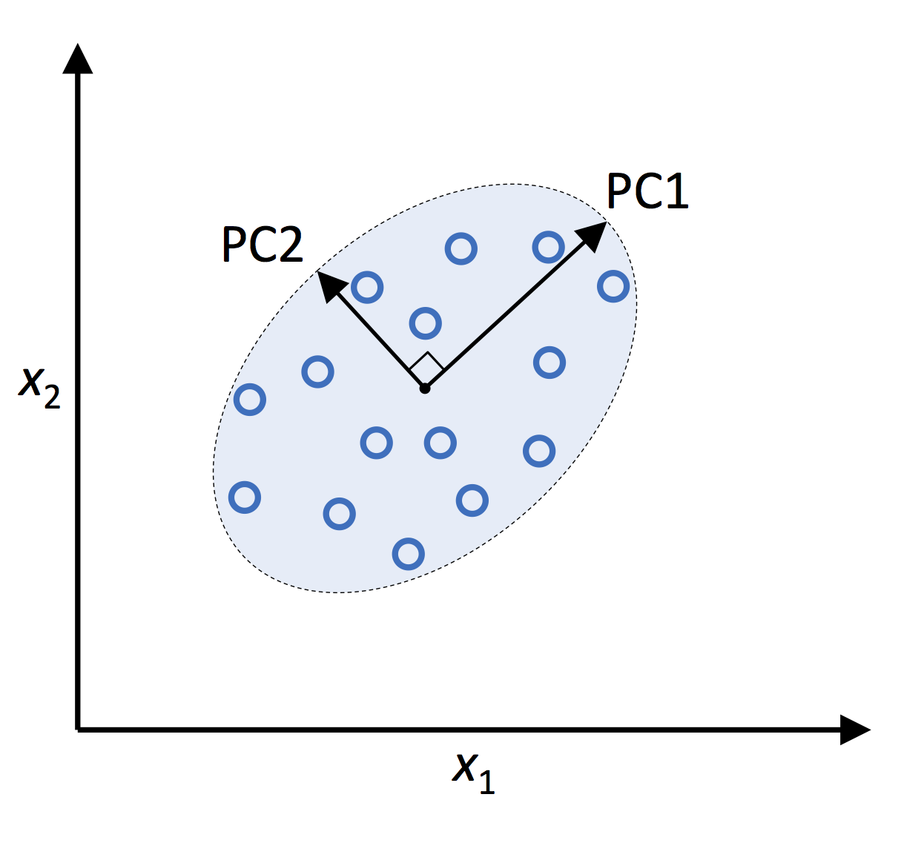
Principal Component Analysis (PCA)
PC1: the vector with the largest variance.
PC2: the vector orthogonal to PC1 with the largest variance.
PC3, PC4, … can be defined similarly.
Assume we have n features, we can compute
PC1, …, PCn. To use PCA for dimensionality reduction,
we can just keep the first k principal components and
omit rest of them.

Slide 27
K-Means

Slide 28
K-Means
K-Means is an unsupervised clustering algorithm used to partition a dataset into K distinct clusters based on similarity. It is one of the most popular and simplest clustering techniques in machine learning.

Slide 29
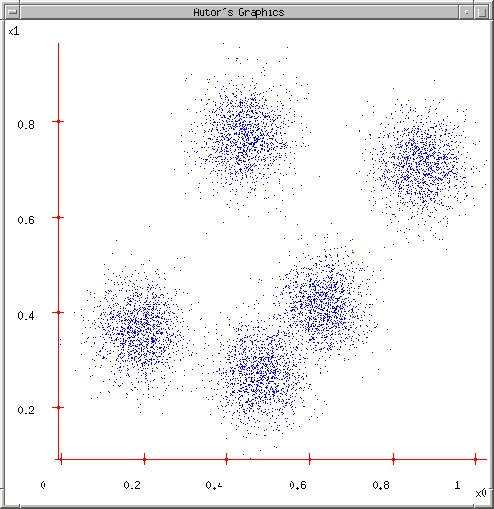
K-means
Ask user how many clusters they’d like. (e.g. k=5)

Slide 30
K-means
Ask user how many clusters they’d like. (e.g. k=5)
Randomly guess k cluster Center locations

Slide 31
K-means
Ask user how many clusters they’d like. (e.g. k=5)
Randomly guess k cluster Center locations
Each datapoint finds out which Center it’s closest to. (Thus each Center “owns” a set of datapoints)

Slide 32
K-means
Ask user how many clusters they’d like. (e.g. k=5)
Randomly guess k cluster Center locations
Each datapoint finds out which Center it’s closest to.
Each Center finds the centroid of the points it owns

Slide 33
K-means
Ask user how many clusters they’d like. (e.g. k=5)
Randomly guess k cluster Center locations
Each datapoint finds out which Center it’s closest to.
Each Center finds the centroid of the points it owns…
…and jumps there
…Repeat until terminated!

Slide 34
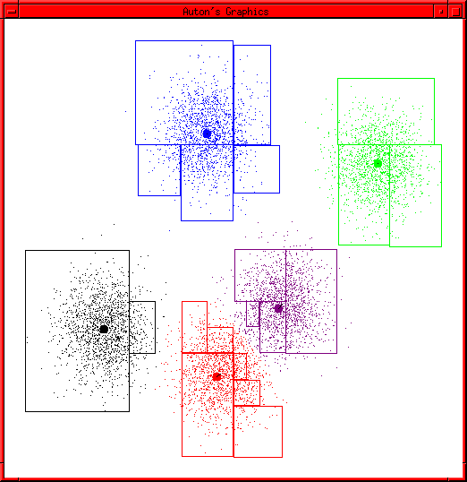
K-means terminates

